Slide 1

OMR Sheet Evaluator Using Image Processing
CSE-3200: System Development Project
Presented by-
Shadman rabby
Roll:1807085
&
Arnob Sarker
Roll:1707088
Supervised By-
Dola Das
Assistant Professor
Department of Computer Science and Engineering
Khulna University of Engineering and Technology
Department of Computer Science and Engineering
Khulna University of Engineering and Technology

Slide 2
Outlines
Objectives
Introduction
Features
Technology Used/ Software Tools
Website Structure
Graphical User Interface (GUI)
Methodology
Performance Analysis
Conclusion and Future Work
References

Slide 3
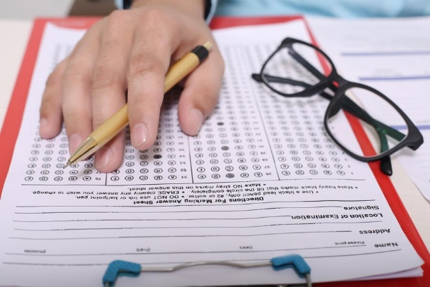
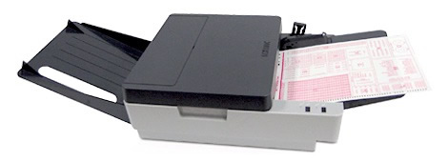

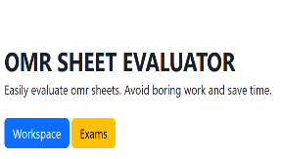
Objectives
Solve real life problem
Evaluate OMR without any heavy machine.
Make OMR evaluator available for everyone
Saving time
Make life easier
Boring work
Not Available

Slide 4
Introduction
OMR is to scan a paper to detect the presence of the mark in a specified location on the sheet.
It has made the tedious job of grading the exam taker easier as the examiner
Competitive exams in Bangladesh stick to the OMR sheets for the calculation of marks.
Our system make OMR sheet evaluation more easy, available for the users
Any camera / smart phone and laptop is enough

Slide 5
Features
• Customizable OMR sheet
• File upload
• Batch mode facility (Multiple OMR can be uploaded at a time)
• variable number of questions
• Display the score
• Show previous exams
• Show individual result

Slide 6
Technology Used
Softwares :
- Microsoft Visual Code
- XAMPP v3.3.0
- Web Browser (Google - Chrome)
- Windows 10
Languages:
- HTML
- CSS
- JavaScript
- PHP
- SQL
- Python

Slide 7
Website Structure
Home page
Log in
Registration
Account
setting
Workspace
Correct sample
image upload
Custimize OMR
Check OMR
Exams
Show previous Exam list
Show Result
Figure 1: Structure of the website

Slide 8
Methodology
Processing the input OMR sheet
Resizing the image
Gray Scale conversion
Gaussian Blur
Edge detection (Canny)
Separating the Rectangles from image
Image thresholding
Figure 2: Steps of processing the image

Slide 9
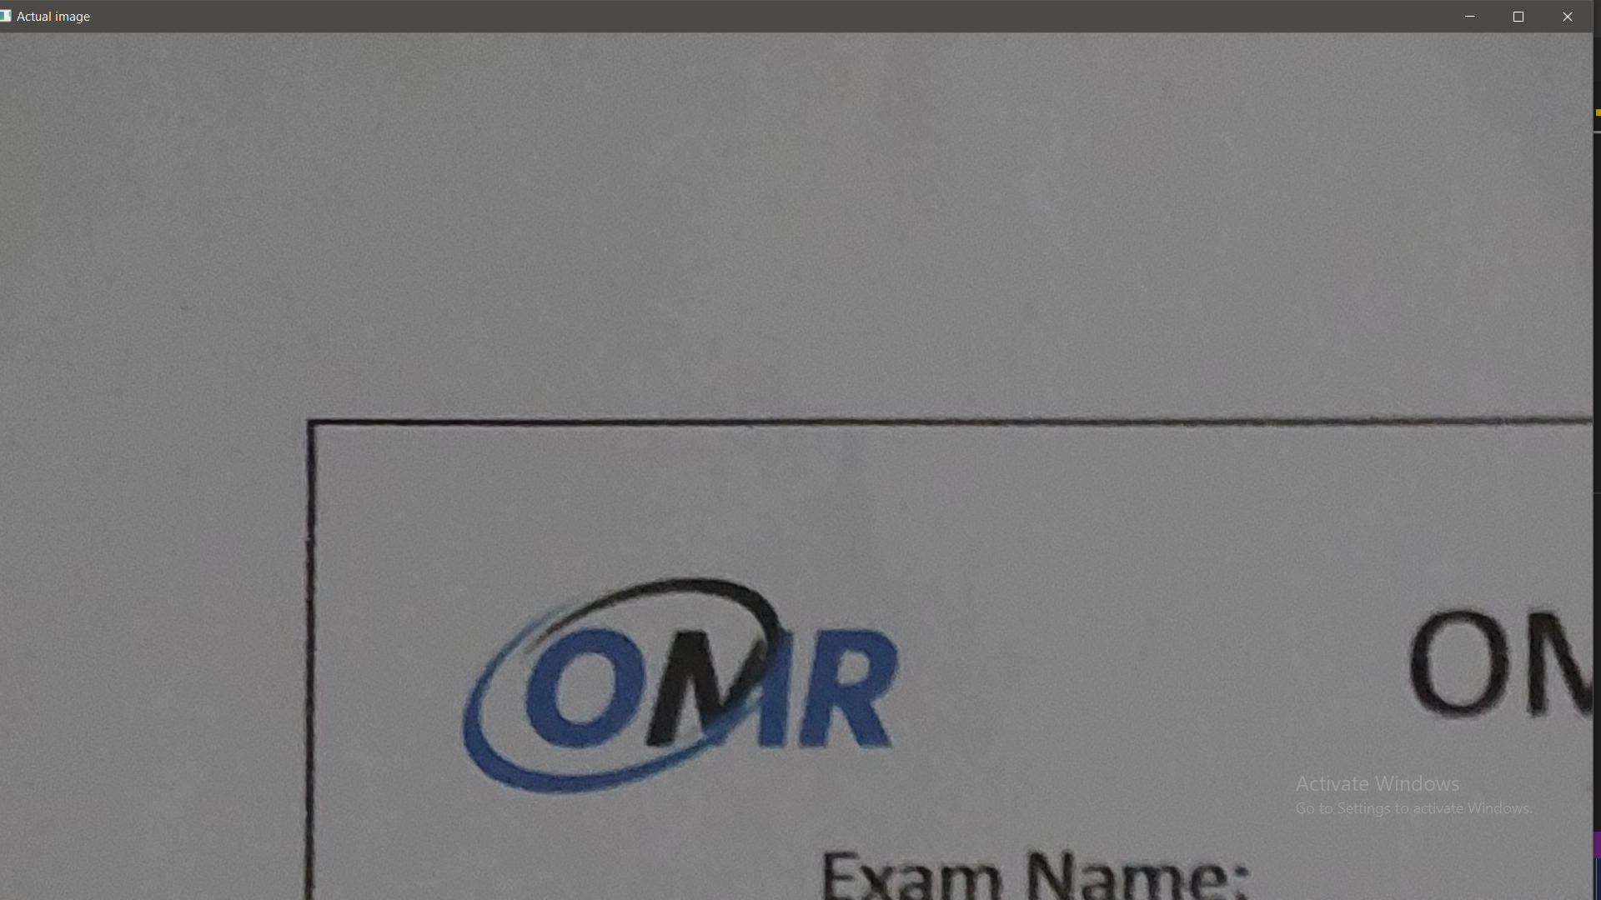
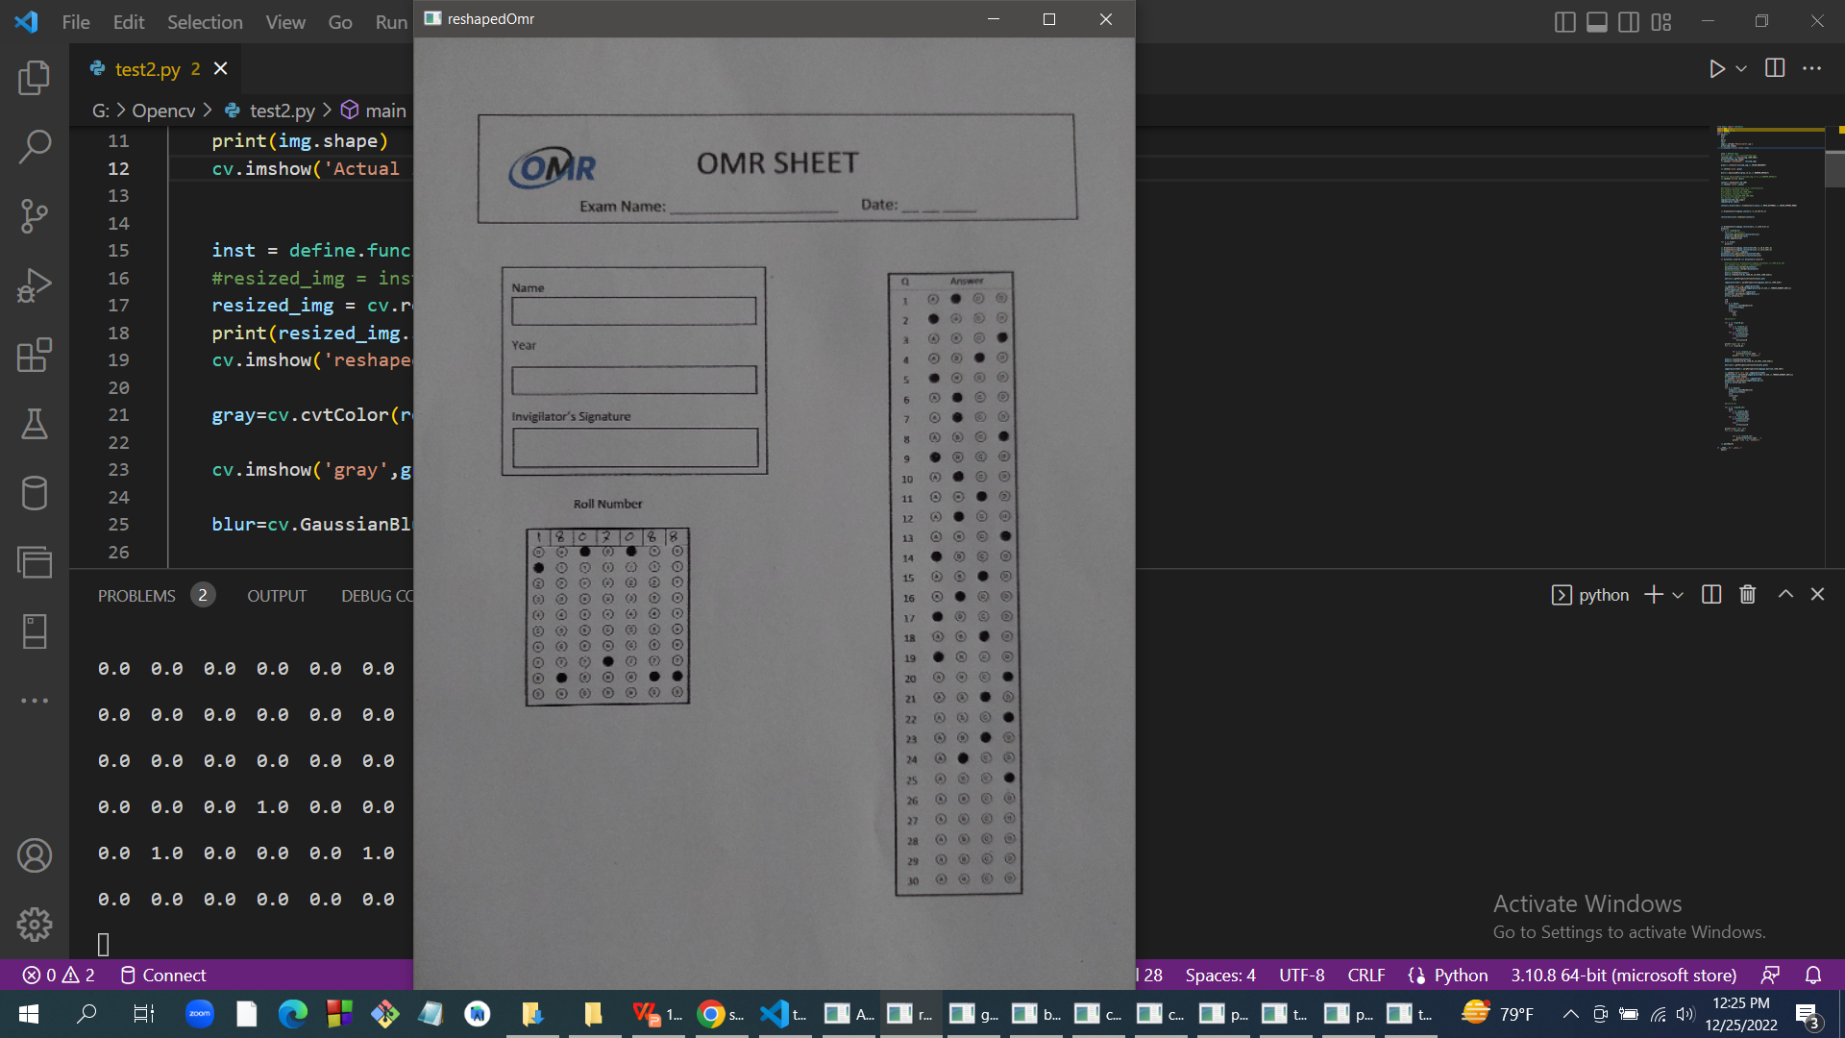
Resizing the input image
Figure 3: Actual 4624 X 3468
Figure 4: Resized 600 X 800

Slide 10
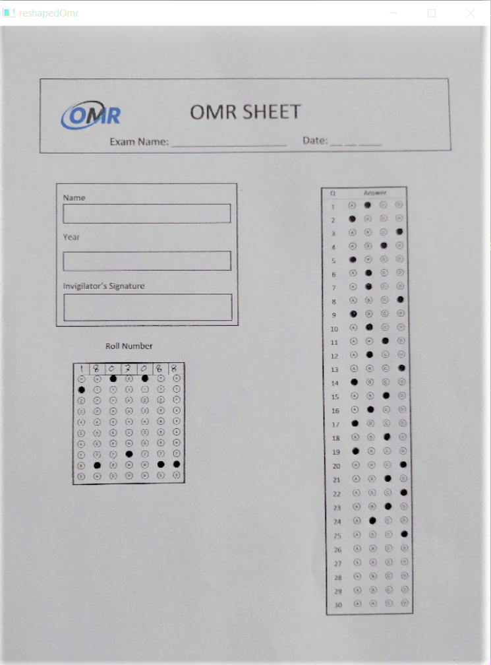
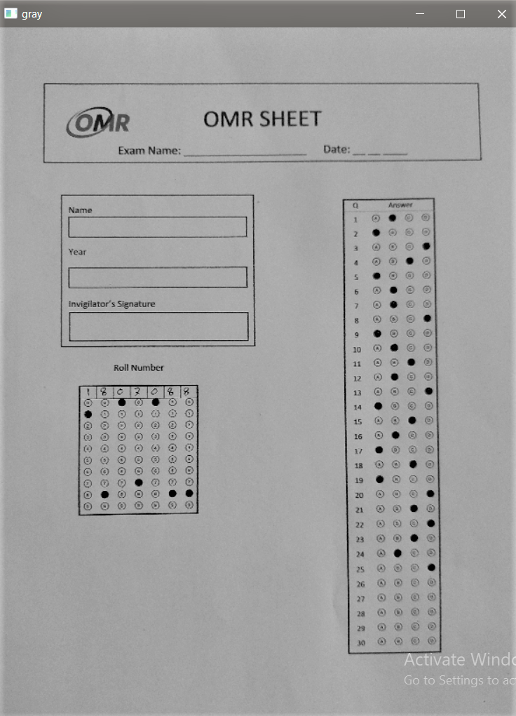
Gray scale conversion
Figure 5: BGR
Figure 6: Gray

Slide 11
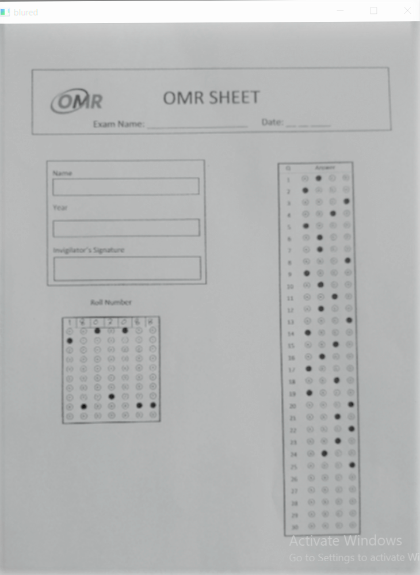
Gaussian Blur
Figure 6: Gray
Figure 7: Blurred

Slide 12
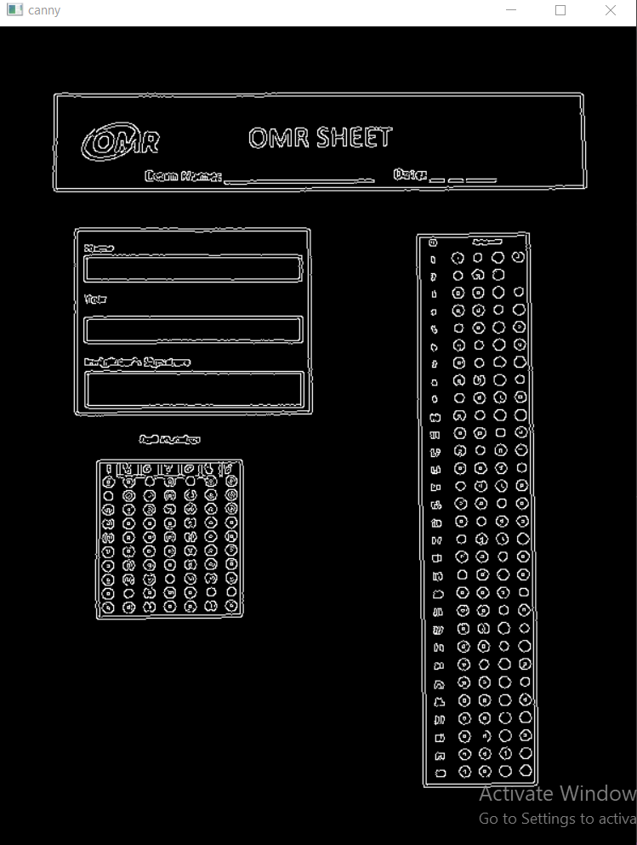
Edge detection (Canny)
Figure 7: Blurred
Figure 8: Edges detected

Slide 13
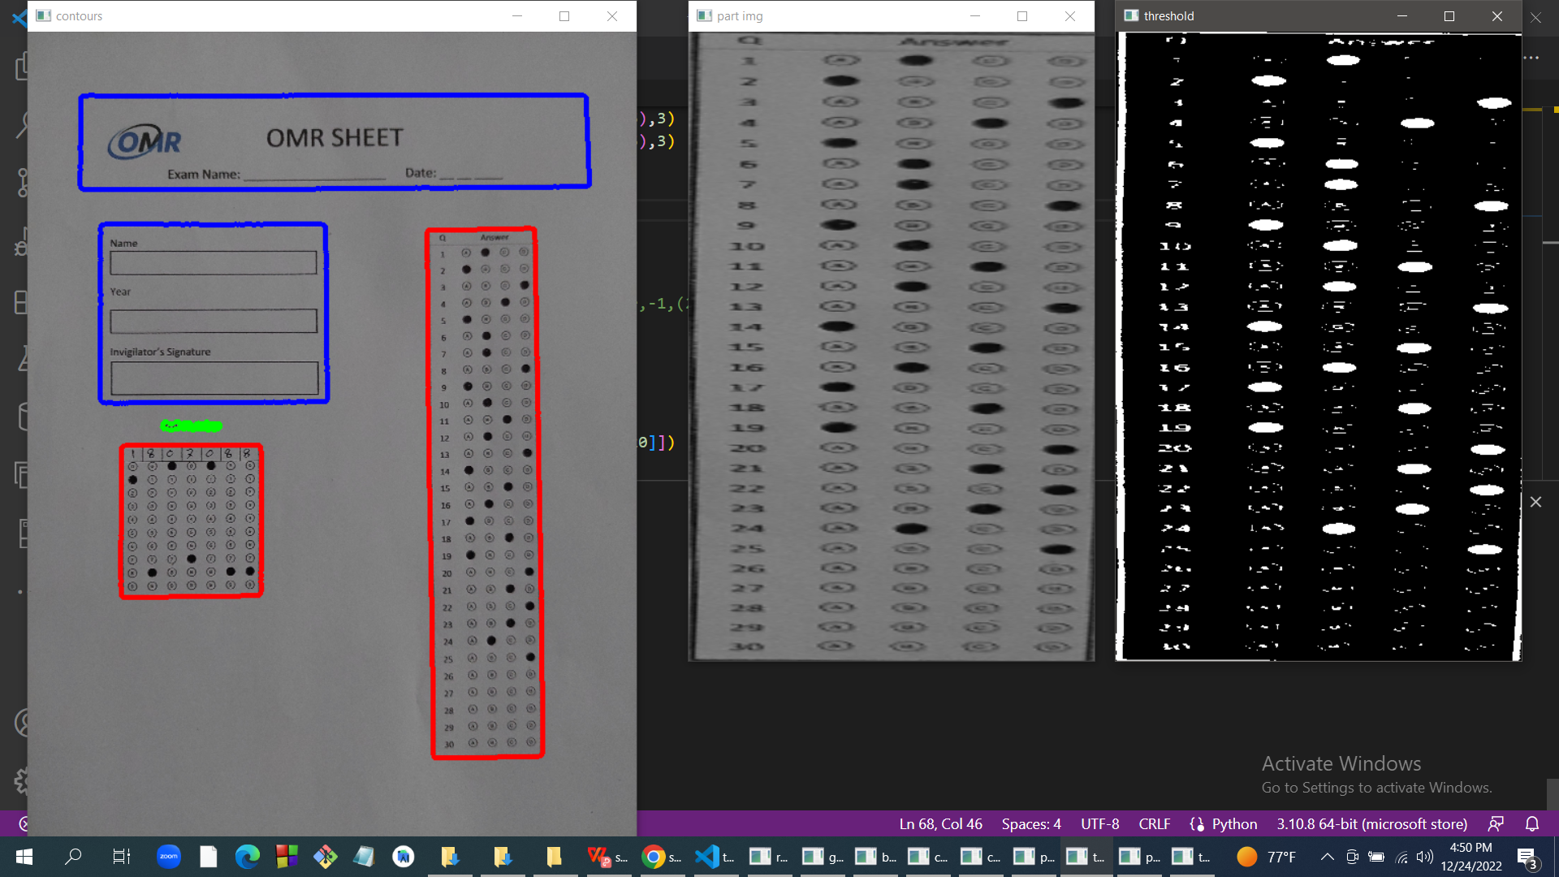
Image Thresholding
Separating the rectangle containing Circled Options
Figure 9: Separating Answer Options rectangle

Slide 14
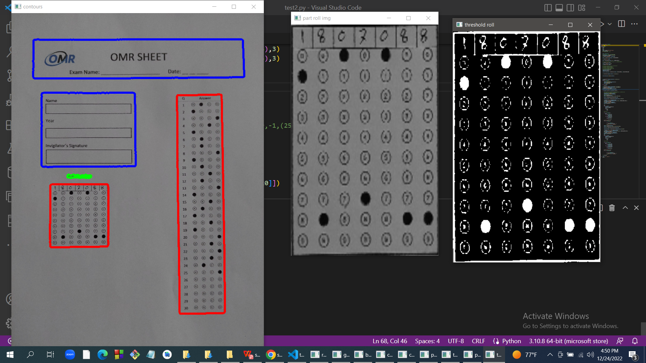
Image Thresholding
Separated Roll Number containing rectangle
Figure 10: Roll No. rectangle extracted

Slide 15
Interfacing between PHP and Python file
We run the python code from php by shellexec() function and pass the image path as the argument.
From python code we pass the roll number and the answers of the MCQs in JSON format and work with that values.
We check the result in PHP and store it in the database against the roll number.

Slide 16
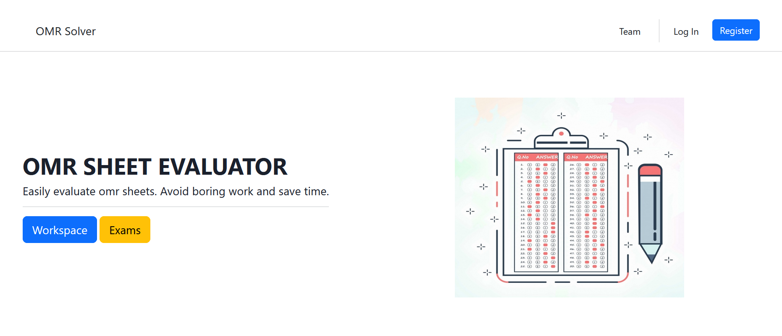
Graphical User Interface (GUI) Homepage
Figure 11: Homepage

Slide 17
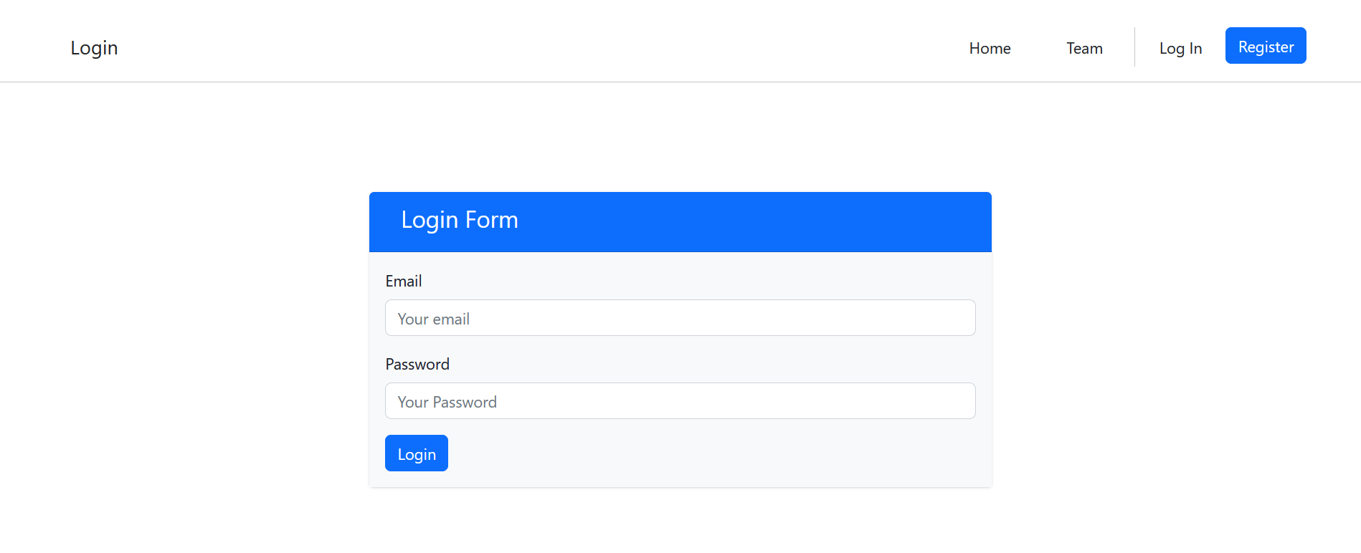
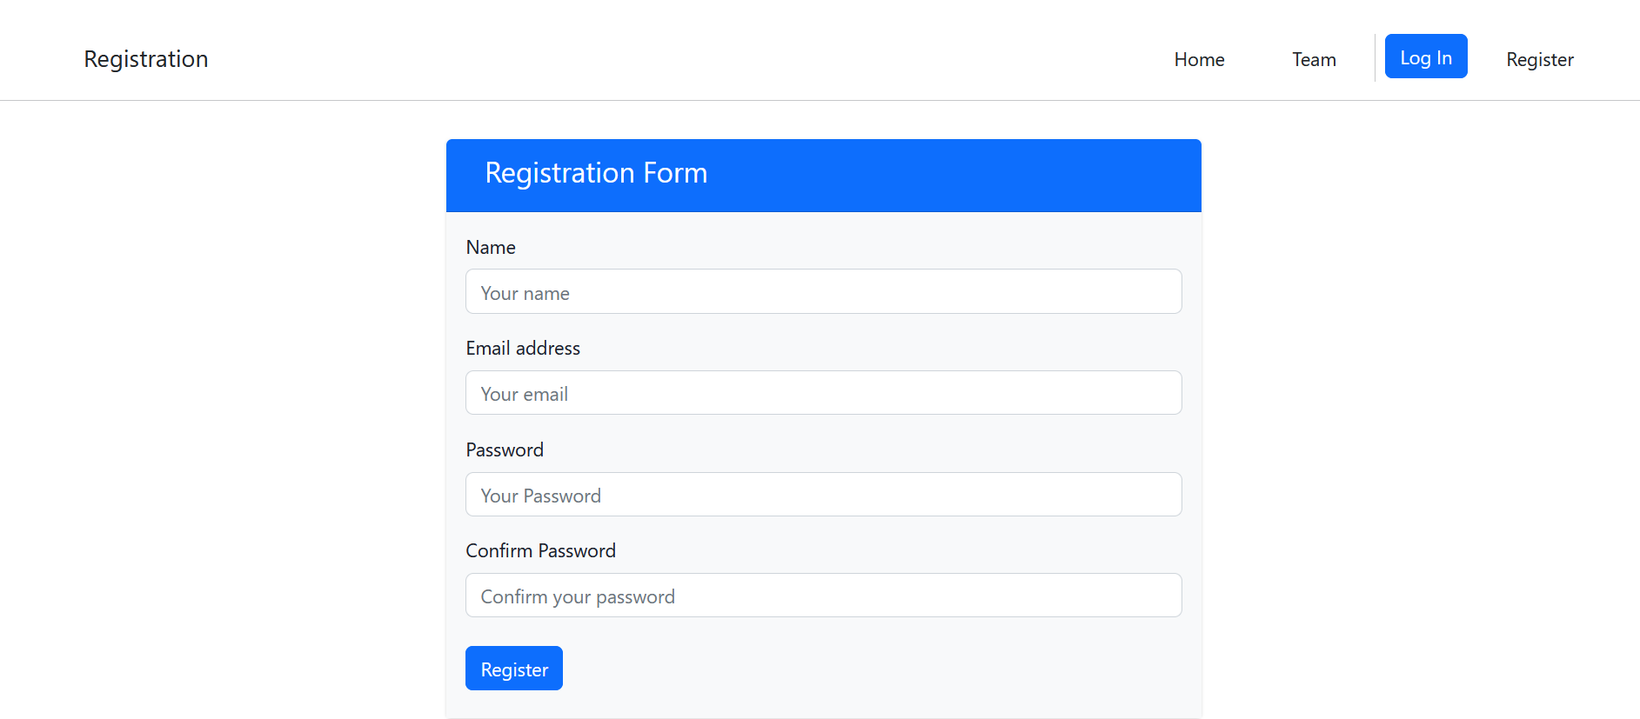
Login Register
Figure 12: Login page
Figure 13: Registration page

Slide 18
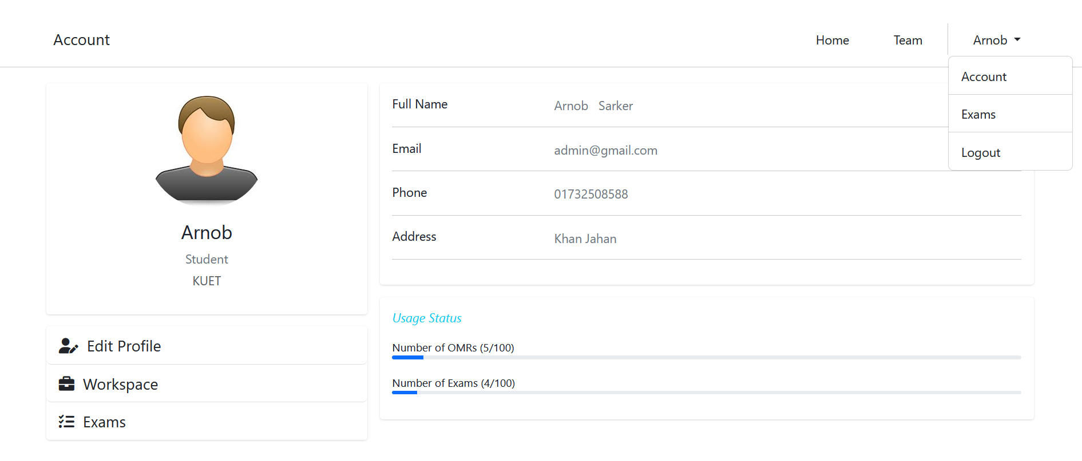
User Profile
Figure 14: Profile of an user

Slide 19
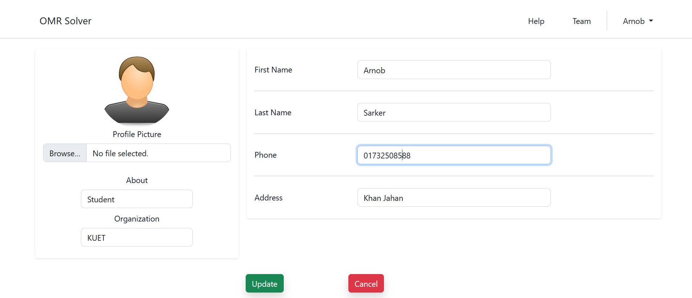
Profile Information Update
Figure 15: Updating profile

Slide 20
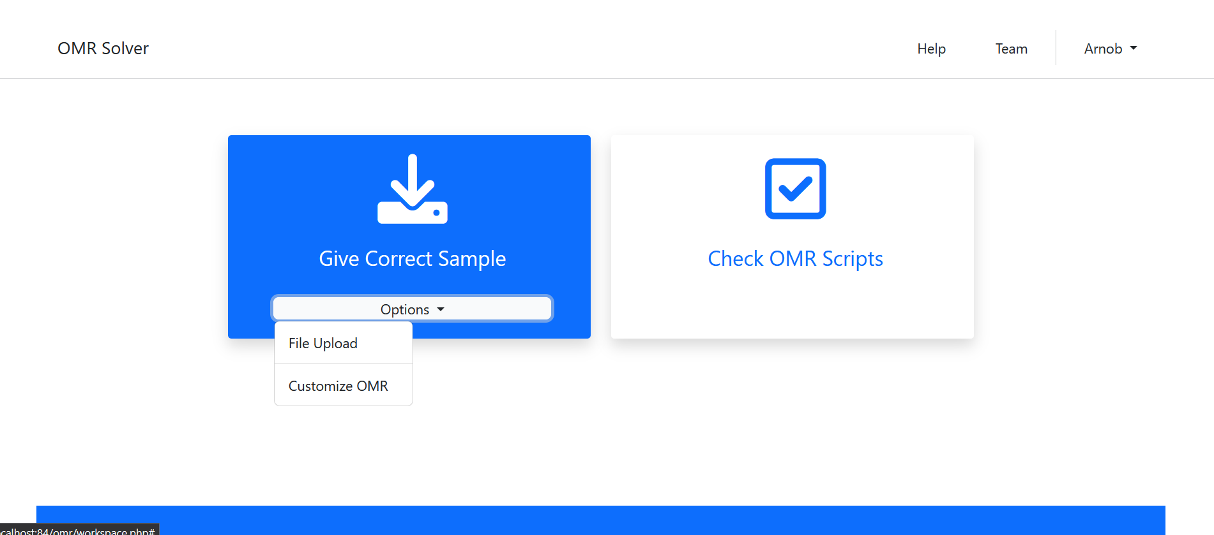
Workspace
Figure 16: Workspace page

Slide 21
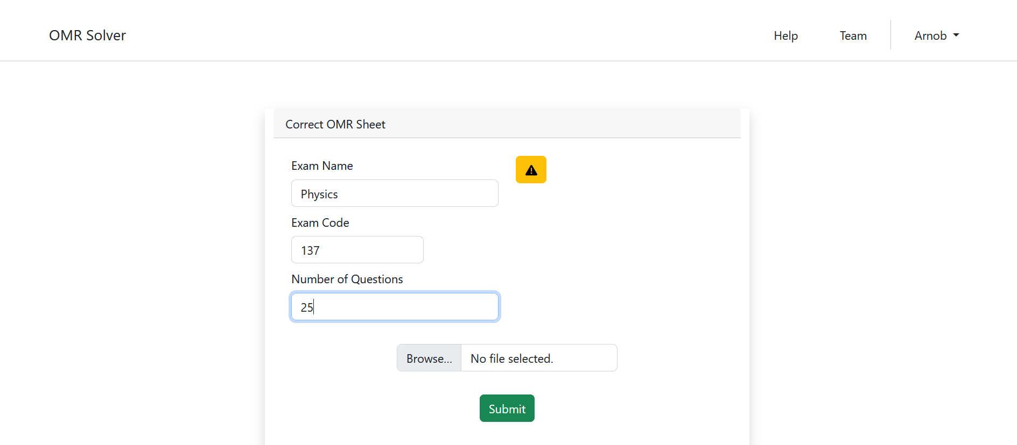
Give Exam details
Figure 17: Exam information submission

Slide 22
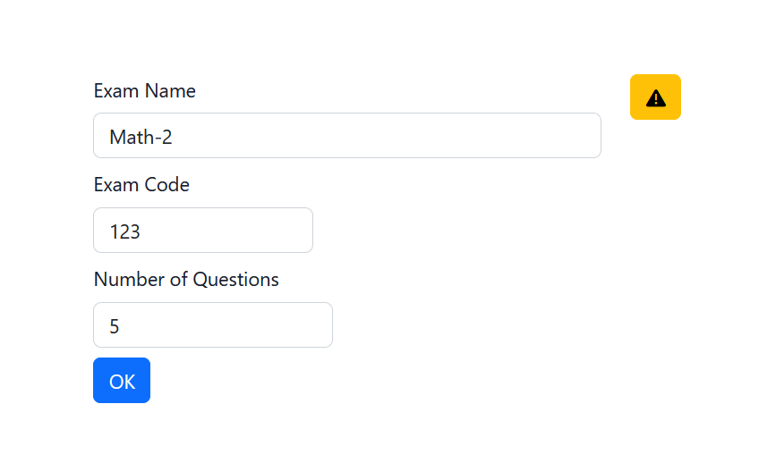
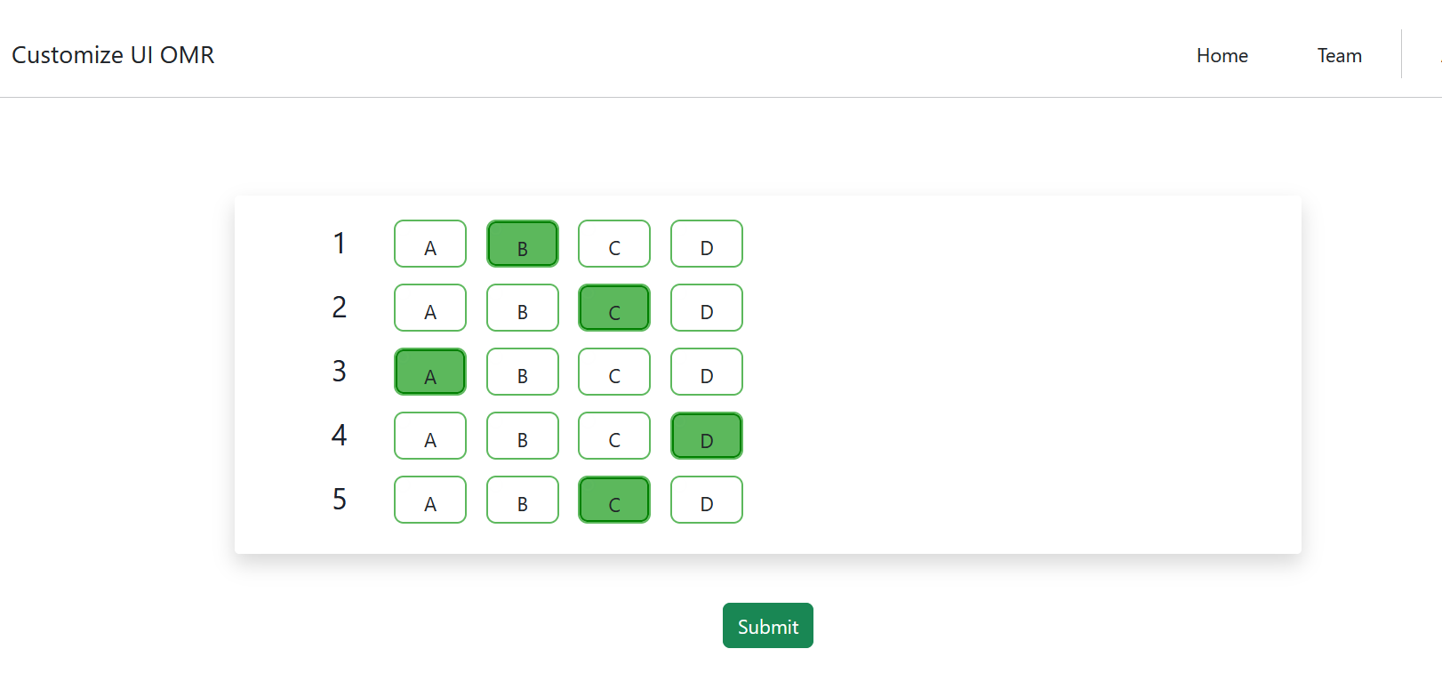
Visual OMR input
Set No of question and Exam details
Select the right options
Figure 18: Selecting Correct Answers

Slide 23
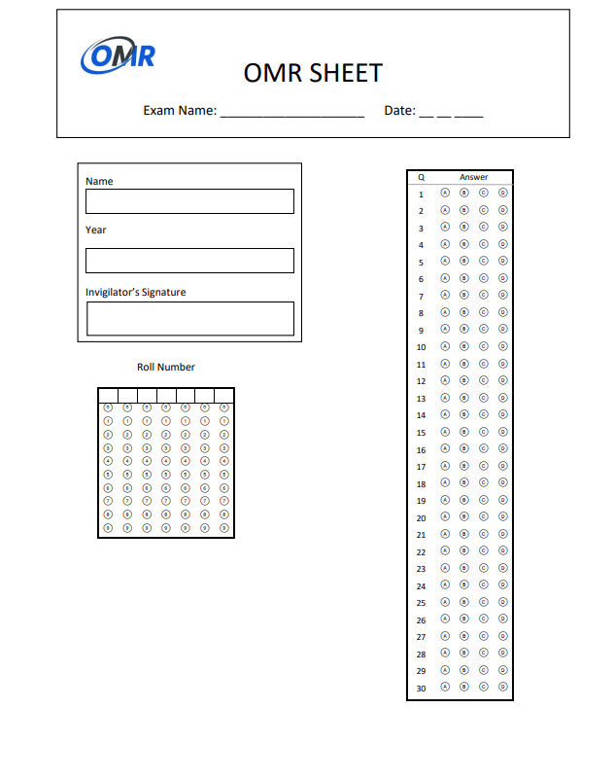
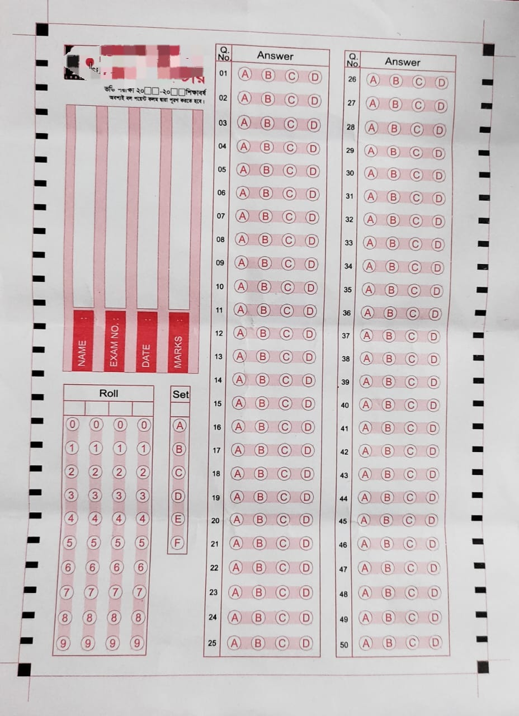
Our Special OMR
Custom OMR
Random OMR
Figure 19: Two types of OMR

Slide 24
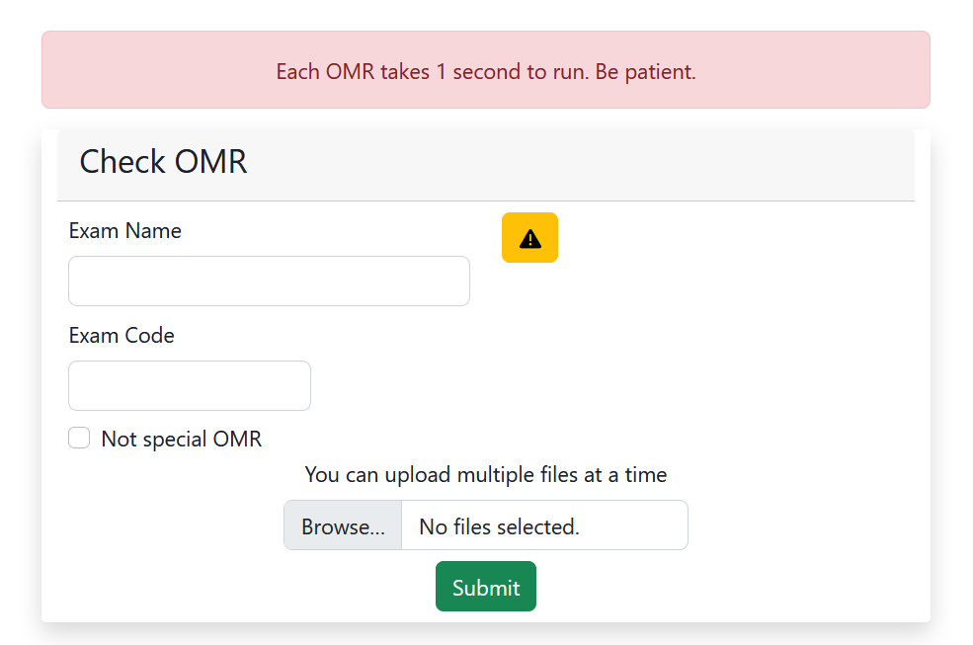
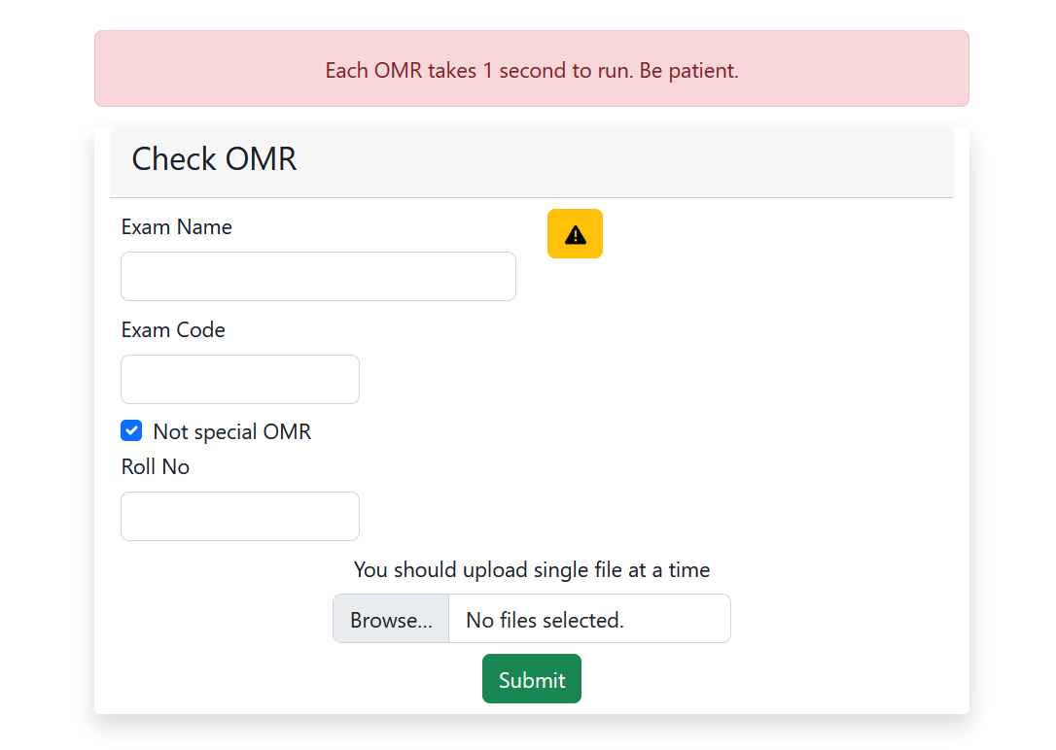
Checking OMR
Batch mode
Single mode
Figure 20: Submit OMR and check result

Slide 25
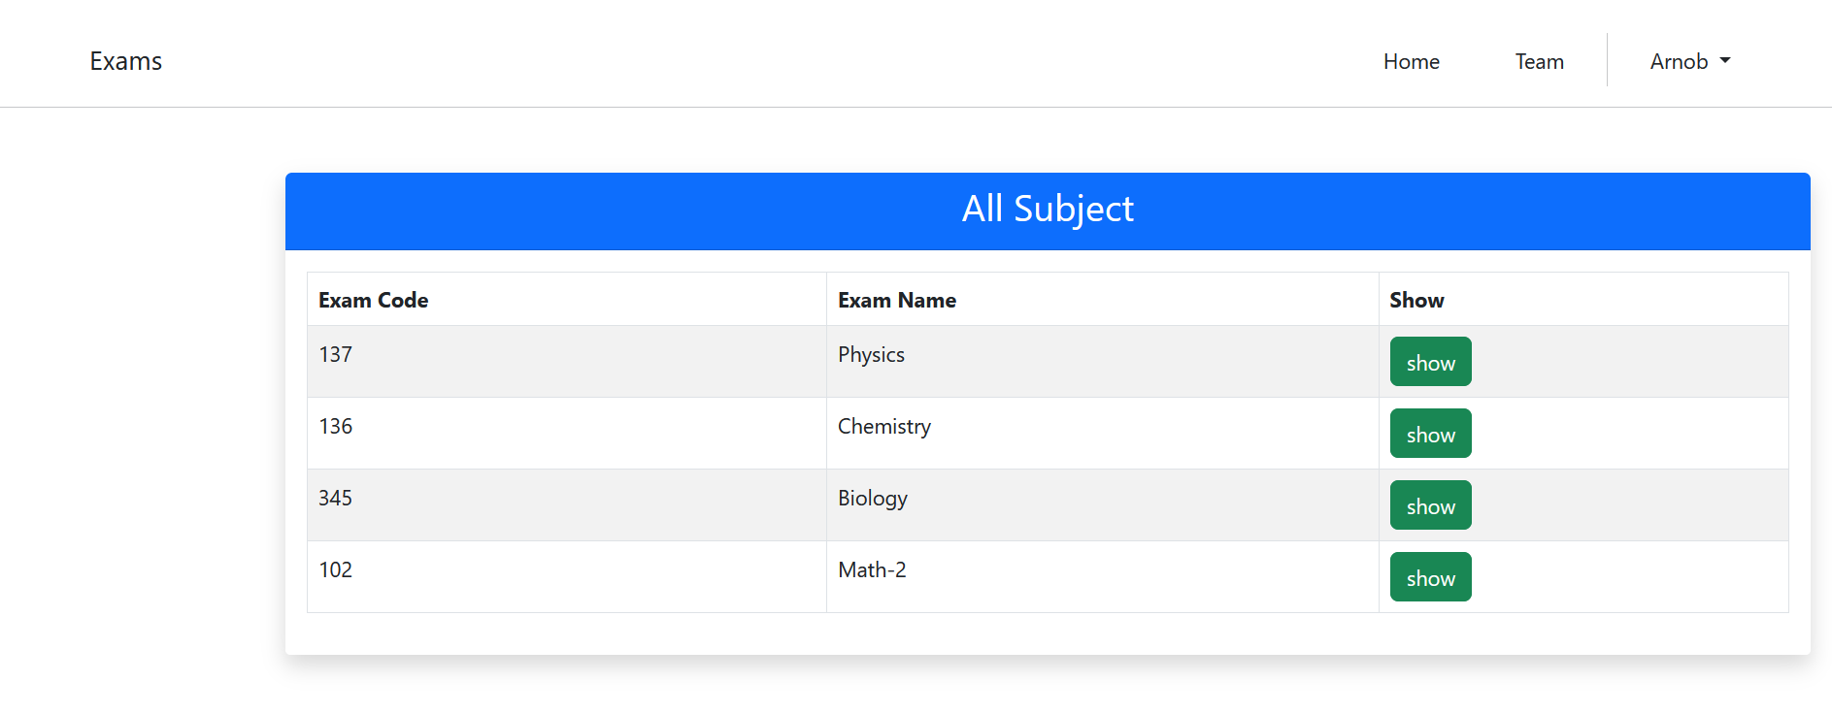
Previous Exams List
Figure 21: Showing the list of exams taken

Slide 26
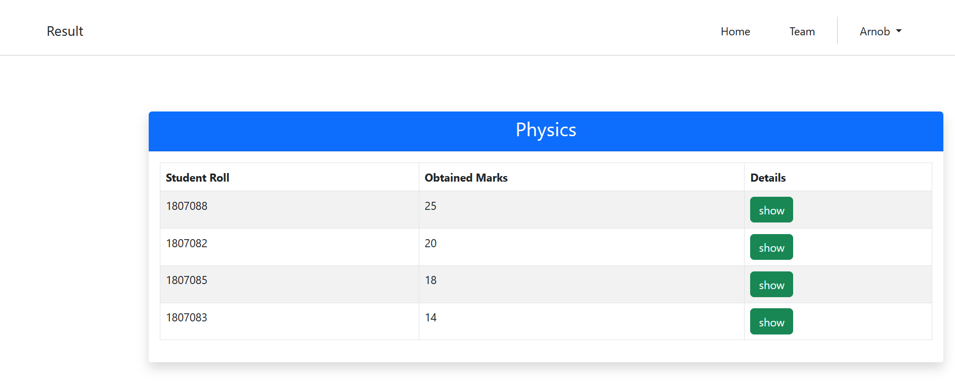
Show Result of Specific Exam
Figure 22: Result of a exam

Slide 27
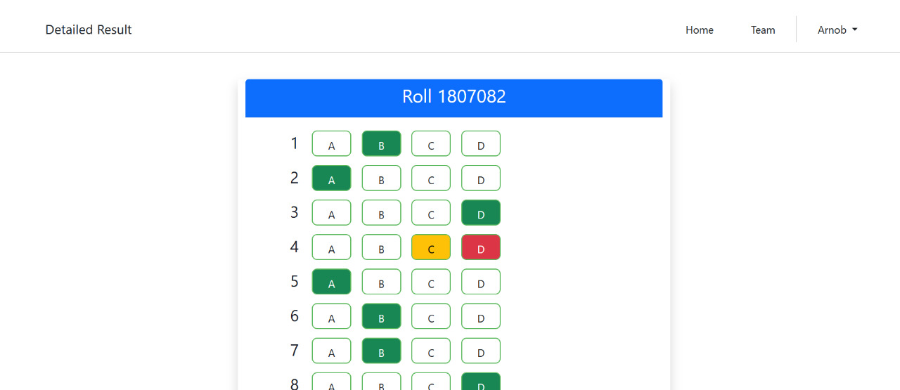
Displaying the Solution
Figure 23: Individual result

Slide 28
Performance Analysis
Case 1: Custom OMR
100% accuracy
Detect roll no perfectly
Case 2: Random OMR
60% accuracy
Can not detect roll no
Had to use additional border

Slide 29
Conclusion & Future Work
We have evaluated OMR sheets using different kind of image processing techniques.
We have created our own OMR sheet (customized) and got expected outcome from it.
We also tested for OMR sheets of some institutions and the result was not satisfactory in some cases.
So in furure we want to improve our system so that it can work accurately for any kind of OMR sheets. And thus we hope OMR sheet evaluator will be more easy to use and available for everyone.

Slide 30
References
Nikita Kakade,2Dr.R.C.Jaiswal,OMR Sheet Evaluator using image Processing ,https://www.jetir.org/papers/JETIR1712119.pdf
https://docs.opencv.org/4.x/
https://getbootstrap.com/
https://www.w3schools.com/php/

Slide 31
Thank you
Everyone

